Slide 1

Concierge Power & Capital (CPC)
Statement of Qualifications

Slide 2


About Concierge Power & Capital (CPC)
Concierge Power & Capital builds, owns, operates, and maintains power generation and energy storage systems in an increasing complex market for energy. Our solutions remove the burdens for our customers of overseeing construction, operations, and maintenance of energy facilities.
The increase in intermittent renewables on the grid, coupled with the rise of extreme weather, has resulted in a less reliable grid and a significant decline in power quality. Most companies lack the experience and domain knowledge to manage their energy demand in this complex and changing energy market.
Our model is simple: CPC provides all the capital and expertise. We select the equipment, and we build, own, operate, and maintain the equipment for the benefit of our customers.
Power You Need. Service That Matters.
02

Slide 3
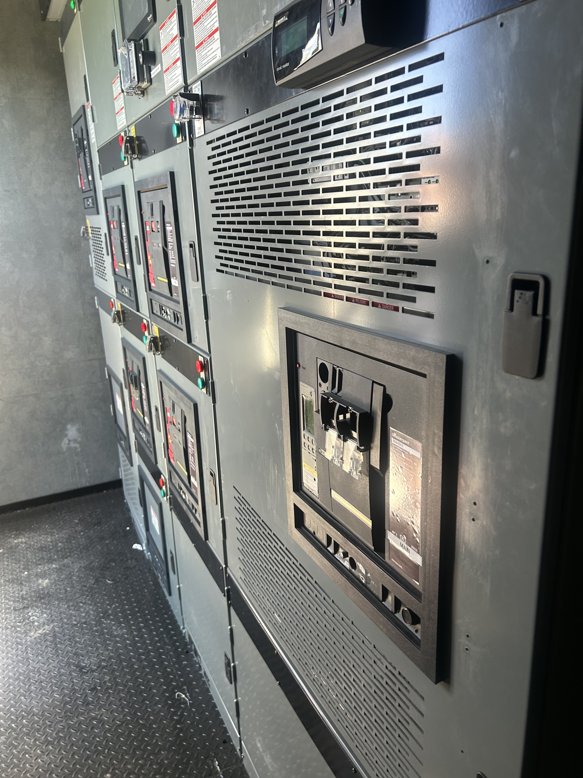

Continuous (Prime) Power
Uninterruptable Power Supplies (“UPS”)
Backup Generators ~ Diesel and Natural Gas
Backup Batteries
100% Financing Under a Service Agreement
Our Services

Slide 4
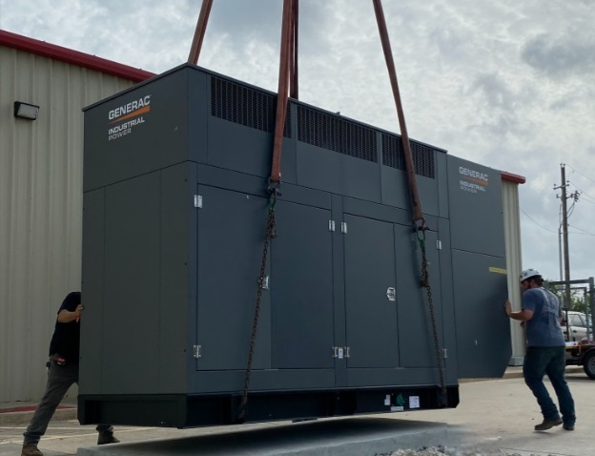
Statement of Qualifications
Development, construction, financing, and operations of:
Natural Gas & Diesel Power Plants
Combined Heat and Power Facilities
Batteries
Solar
Over 448 MW Deployed, Including:
Elanco US Inc. – Indianapolis, IN & Fort Dodge, IA
BMO Harris Center – Rockford, IL
Soft Gel Technologies – Los Angeles, CA
Del Papa Distributing – Victoria & Texas City, TX
Upper Crust Bakery – Glenn Dale, MD
Repligen Corp – Marlborough, MA
SelecTransportation – Houston, TX
Silverleaf Eldercare – Multiple Locations in Texas
DK LIPA LLC – Brookhaven, NY
Boys & Girls Club – San Leandro, CA
United Methodist Church – Moorestown, NJ
Community Schools – Bethany, CT
Developed multiple projects for:
    Pyrolysis Conversion
    Plastics Recycling
    Anaerobic Digestion Power Plants

Slide 5
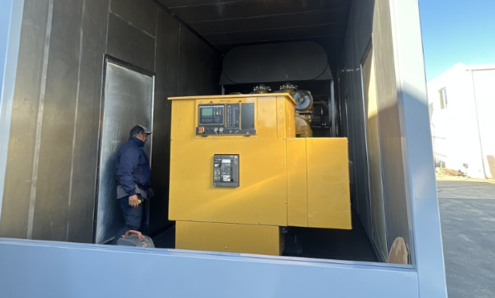
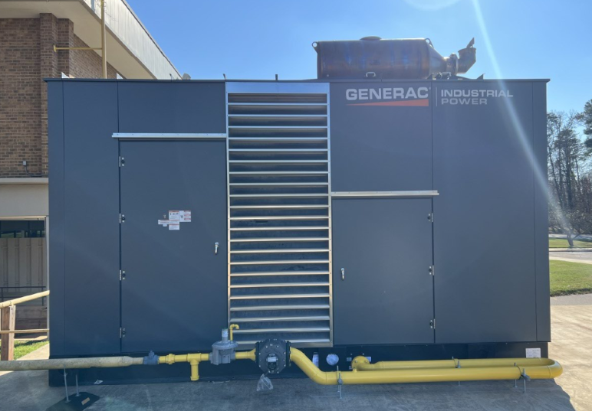
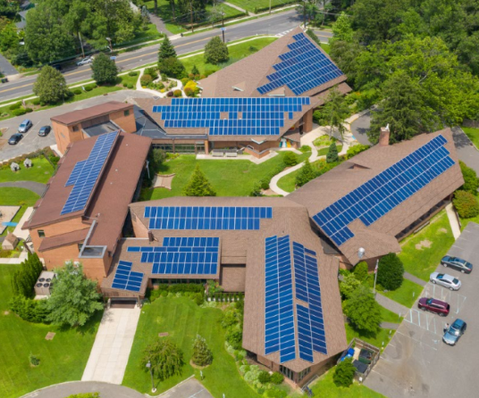
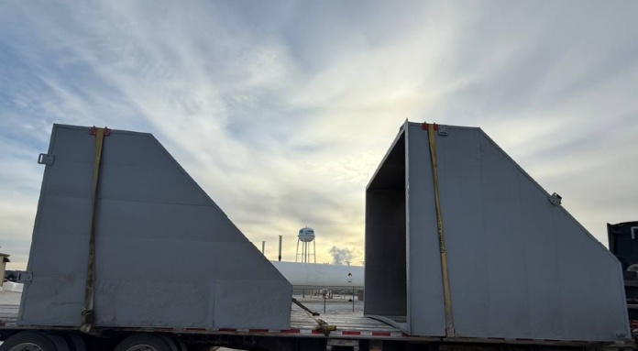









References
We serve a wide range of clients, customizing the right solutions for their unique needs.

Slide 6
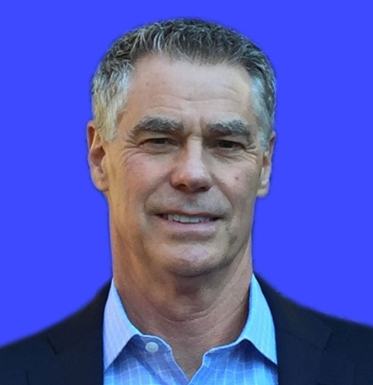
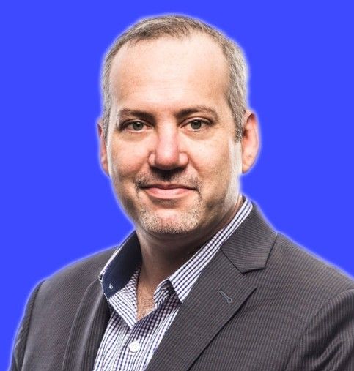
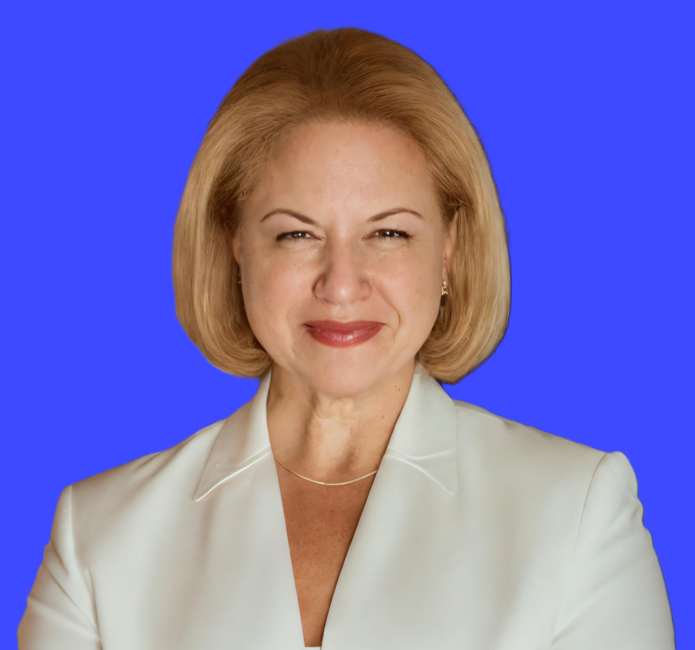
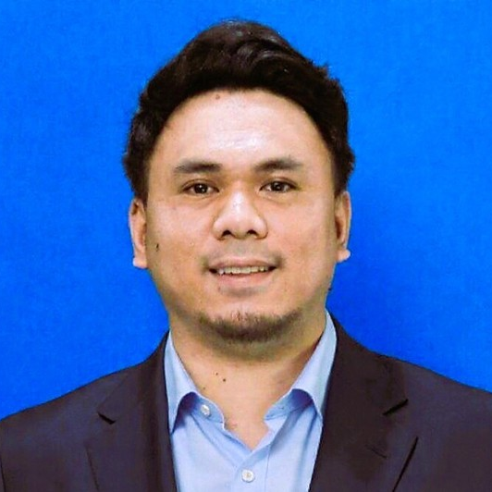
Our Leadership Team
David March
Chief Executive Officer
March@conciergepowercapital.com
David Kurzman
Chief Financial Officer
Kurzman@conciergepowercapital.com
Veronica Lombardi
Chief of Staff & Project Manager
Lombardi@conciergepowercapital.com
Martin Lopez
Revenue Operations Leader
Lopez@conciergepowercapital.com
As CEO, David oversees all strategic business development efforts at Exergy Energy.
He has been a serial entrepreneur in the energy and technology sectors having founded and run several high-technology instrumentation and software companies.
David earned a B.S. in Engineering Chemistry and an MBA in Quantitative Finance from Lehigh University.
He has also been awarded two patents in operational efficiency and optimization in complex process industries.
To date David has successfully completed 55 generation projects ranging from 1MW to 100 MW.
David leads finance and operations at the firm, serving as its Chief Financial Officer.
He has held several leadership roles as Portfolio Manager, Managing Partner of a CleanTech hedge fund, and he has held several research positions for private firms, investment banks, and a Registered Investment Company.
David earned his B.A. from Grinnell College, completed additional classes in accounting at Drake University, and holds an active Series 7/Registered Representatives license.
Veronica is Chief of Staff and Project Manager.
She has led project administration and client success teams for many years.
Prior to joining CPC, she managed operations for a solar development company, completing over 100 systems around the country and currently in operation.
Veronica earned her B.A. from Pomona College and holds certifications in sales and service.
Martin is Revenue Operations Leader with a background in business development and sales strategy.
Prior to transitioning into Revenue Operations, he played a key role in driving outbound growth, managing sales pipelines, and optimizing CRM systems to improve visibility and performance.
Today, he focuses on building scalable, data-driven processes that align marketing, sales, and operations for sustainable growth.
06

